Slide 1

A Major Project On Quality detection of fruits and vegetables using Artificial Intelligence BACHELOR OF TECHNOLOGY In COMPUTER SCIENCE AND ENGINEERING By M.MARUTHI (197R1A05M6) N.SAMPATH KUMAR (197R1A05N5) AKHILA (197R1A05P5) Under the Guidance of DR.PRABHU A (Associate Professor)
DEPARTMENT OF COMPUTER SCIENCE AND ENGINEERING
CMR TECHNICAL CAMPUS
UGC AUTONOMOUS
(Accredited by NAAC, NBA, Permanently Affiliated to JNTUH, Approved by AICTE, New Delhi) Recognized Under Section 2(f) & 12(B) of the UGC Act.1956, Kandlakoya (V), Medchal Road, Hyderabad-501401.
2019-2023

Slide 2
ABSTRACT
Automation of Fruit is an interesting application of computer vision. Traditional fruit classification methods have often relied on manual operations based on manual operations based on visual ability and such methods are tedious , time consuming and inconsistent.
External shape appearance is the main source for fruit classification. In recent years ,computer machine vision and image processing techniques have been found increasingly useful in the fruit industry ,especially for applications in quality inspection and colour ,size , shape sorting .

Slide 3
EXISTING SYSTEM
In the past decades , Profound learning-based characterizations are making it possible to recognize fruits from pictures.
However ,Fruits recognition is still a problem for the stacked fruits on a weighing scale because of the complexity and similarity.
In 2009, Woo Chaw Seng, Seyed Hadi Mirisaee[7] proposed a Fruit Recognition System. The system was applied on fifty image samples.The mean colour values of these images are computed.The fruit area and perimeter are chosen as features to distinguish one fruit from another.

Slide 4
DISADVANTAGES
This system uses a smaller number of algorithms to build model.
Accuracy is less and performance is not optimized.

Slide 5
PROPOSED SYSTEM
We collected about 50-60 image samples of the same item, all of varying values of attributes from a fixed distance and using the same device. These images serve as an input to image processing through which we obtained training dataset by extracting various attributes of images, such as area, roundness, skewness, kurtosis, color intensity etc. This phase includes processing on image such as background removal, fruit image extraction, color value extraction, as well as size extraction.

Slide 6
ADVANTAGES
Algorithms like Random forest, Xgboost, KNN Regressor, Ridge and Lasso Regression
Accuracy is more than existing system, User friendly UI using Flask

Slide 7
HARDWARE REQUIRMENTS
SYSTEM :I5 Processor & basic GPU
HARD DISK: 500 GB
RAM : 8GB
INPUT DEVICE :Standard Keyboard and Mouse
OUTPUT DEVICE :VGM and High-resolution Monitor

Slide 8
SOFTWARE REQUIRMENTS
OPERATING SYSTEM :Windows 10
CODING LANGUAGE : Python

Slide 9
NOVELTY
External shape appearance is the main source for fruit classification. In recent years ,computer machine vision and image processing techniques have been found increasingly useful in the fruit industry ,especially for applications in quality inspection and colour ,size , shape sorting .
computer machine vision and image processing techniques have been found increasingly useful in the fruit industry, especially for applications in quality inspection and color, size, shape sorting

Slide 10
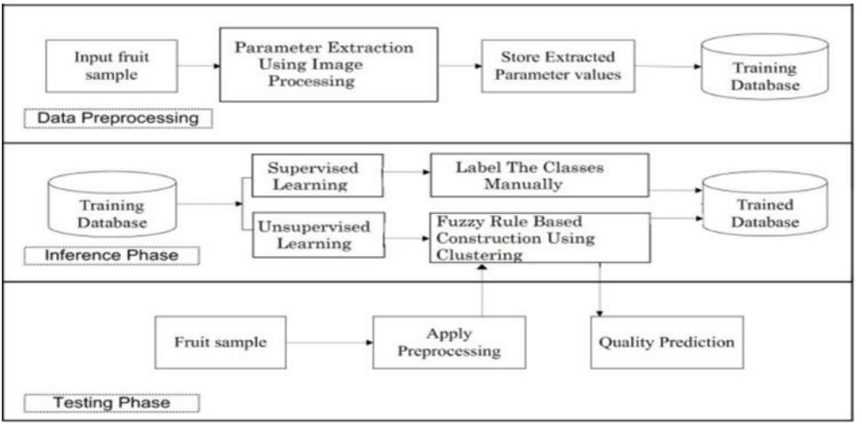
ARCHITECTURE

Slide 11
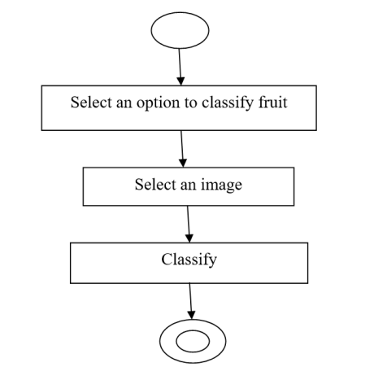
MODULE

Slide 12
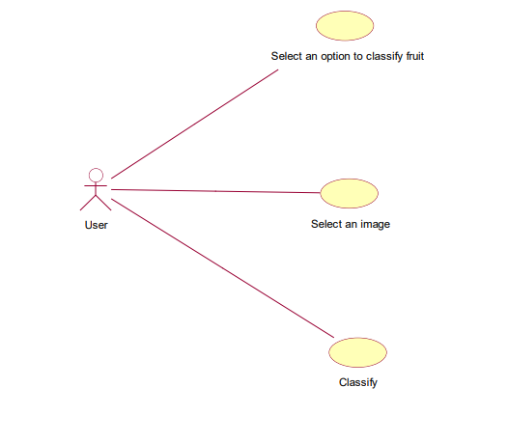
UML DIAGRAMS
USE CASE DIAGRAM:

Slide 13
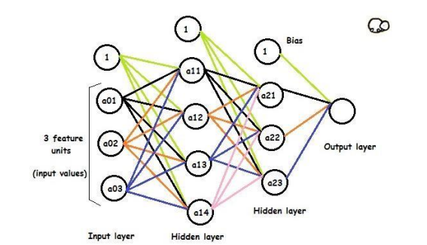
CLASS DIAGRAM:

Slide 14
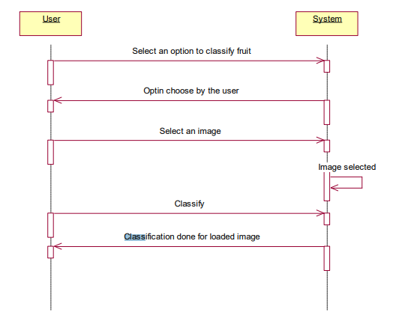
SEQUENCE DIAGRAM:

Slide 15
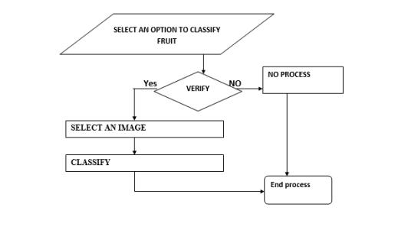
ACTIVITY DIAGRAM:

Slide 16
CONCLUSION
The proposed framework aims to predict the quality of fruits and vegetables to a great accuracy. The quality of fruits or vegetables plays an important role in consumer consumption and thereby affecting its sales. In India most of the population survival is based on agricultural products. All the business and organizations that make, display, transport or prepare food for sale they will need to check food quality. If we are able to identify the maturity of fresh fruit, then it will be very beneficial to farmers as they can optimize their harvesting. This ability will help them avoid harvesting under-matured or overmatured fruits. This study attempted to use image processing techniques to extract colour, size and other attributes of the image forming training dataset. We use regression analysis to identify dependencies among variables. Here we use multivalued regression models that considers multiple independent variables and one dependent variable.

Slide 17
THANK YOU

